Slide 1
Analysis of Financial Statements
Financial Statement and Reports
Concept of financial statement analysis
Users of financial analysis
Tools of financial statements analysis
Need for financial ratio analysis
Types of financial ratios
Liquidity ratios
Assets Management ratios
Debt Management ratios
Profitability ratios
Market value ratios
Du-Pont Equations
Comparative ratios and benchmarking
Uses and Limitations of ratio analysis

Slide 2
Financial Statements and Reports
Annual report: A report issued annually by a corporation to its stockholders. It contains basic financial statements, as well as management’s analysis of the past year’s operations and opinions about the firm’s future prospects.
Financial Statement: Contain the basic financial information about revenues, expenditures, expenses, assets, liabilities, cash flow during a specified period
Financial statement reports what has actually happened to assets, earnings and dividends over the past few years whereas verbal statement attempts to explain why things turned out the way they did
Prepared in accordance with Generally Accepted Accounting Principles (GAAP)

Slide 3
Role of financial statement
Useful in reporting
Useful in business decision making
Useful in forecasting
Other uses
Cash flow to know cash position
To access the viability of investing in business
Whether to grant loan to business or not
Accuracy of tax declared and tax paid
To access creditworthiness of business

Slide 4
Financial Statement and Reports
Balance sheet – provide snapshot of a firm’s financial position at one point of time
Income Statement – summarizes a firm’s revenues and expenses over a given period of time
Statement of cash flow – reports the impact of a firm’s activities on cash flow over a given period of time
Statement of change in shareholders equity – reconciliation between the opening balance and closing balance of shareholder’s equity
(Detail about format and items of each statement will be discussed during numerical portion)

Slide 5
Users of Financial Statement Analysis
Financial statement Analysis: Process of analyzing relative strengths and weaknesses of firm’s financial position.
Analyzing financial statements prepared in accordance with GAAP to ascertain the information concerning the magnitude, timing and riskiness of future cash flows associated with a firm.
Users:
Management= overall strength and weakness of the firms
Shareholders= earnings of company
Short-term creditors= short term solvency position
Institutional lenders and bondholders= fixed charge payment capacity
Regulatory Bodies= compliance requirements

Slide 6
Tools of financial statement analysis
Common size statement analysis
Index analysis
Financial ratio analysis

Slide 7
Common Size Statement Analysis
Difficult to directly compare the financial statements of two firms because of size differences.
Also difficult for the same firm if size has changed or to be compared with a foreign firm.
Common size statement analysis is a technique used in financial analysis to compare the financial statements of companies of different sizes.
Common size analysis consists of computing percentages of each item over total assets in case of balance sheet.
In case of income statement, percentages are computed over sales.

Slide 8
The Balance Sheet :
NEPAL BRICK FACTORY LTD. (‘000 Rs.)
Liabilities and equity Year 2 % of TA
Accounts payable 2,000 10
Notes payable 400 2
Accrued wages 800 4
Other accruals 800 4
Current Liabilities 4,000 20
Long-term debt 6,000 30
Preferred stock 0 0
Stockholder’s equity:
Com. Stock (Par Rs.100) 2,000 10
Paid in Capital 2,000 10
Retained Earnings 6,000 30
Total Stockholders’ eq. 10,000 50
Total liab.& eq. 20,000 100

Slide 9
Assets Year 2 % of TA
Cash 1,000 5
Marketable securities 1,000 5
A/cs. receivables, net 2,400 12
Inventories 3,600 18
Prepaid expenses 0 0
Current assets 8,000 40
Gross Fixed Assets:
Land 1,000 5
Building 5,500 27.5
Machinery & equip. 9,500 47.5
Other fixed assets 4,000 20
Total Fixed Assets 20,000 100
Less Depreciation -8,000 40
Net Fixed Assets 12,000 60
Total Assets 20,000 100

Slide 10
2. The Income Statement
Particulars Year 2 % of S.
Revenues 24,000 100
Cost of sales -13,600 56.7
Gross income 10,400 43.3
Marketing expense -6,000 25
General & adm. Exps. -1,200 5
EBDIT 3,200 13.3
Depreciation -1,000 4.2
Net ope.income (NOI) 2,200 9.1
Other income, net +240 +1.0
EBIT 2,440 10.1
Interest expenses -440 1.8
EBT 2,000 8.3
Income taxes @ 40% -800 3.3
Net income 1,200 5.0

Slide 11
Index Analysis
Expressing each items in balance sheet and income statement as a percentage against base year.
Particulars | Regular (Rs in ‘000) |  | Index (%)
 | 2022 | 2023 | 2022 | 2023
Sales revenue | 3,946,476 | 4,442,375 | 100 | 112.6
Less: COGS except depreciation | 2,006,171 | 2,283,003 | 100 | 113.8
Depreciation and amortization | 26,434 | 32,987 | 100 | 124.8
Other operating expenses | 1,012,699 | 1,483,299 | 100 | 146.5
Net operating income | 901,172 | 643,086 | 100 | 71.4
Add: Other Income | 512,725 | 626,332 | 100 | 122.2
Earnings before income and tax | 1,413,897 | 1,269,418 | 100 | 89.8
Less: Interest Expenses | 6,417 | 8,724 | 100 | 136.0
Earnings before tax | 1,407,480 | 1,260,694 | 100 | 89.6
Less: tax | 285,802 | 295,465 | 100 | 103.4
Net Income | 1,121,678 | 965,229 | 100 | 86.1

Slide 12
Ratio Analysis
Financial ratio:
quantitative relationship between two or more sets of financial data derived from income statement and balance sheet.
it provides strength and weakness on various aspects of the firm’s performance and status
are designed to help evaluate financial statements

Slide 13
Users of Financial Ratios
Creditors, owners, management, employees, consumers, government, etc.
1.Short term creditors: liquidity ratios
2.Long-term creditors: debt ratios, interest coverages, & profitability ratios.
3.Equityholders: profitability, growth, & valuation.
4.Management: all ratios.
5.Credit rating agencies: Purpose?

Slide 14
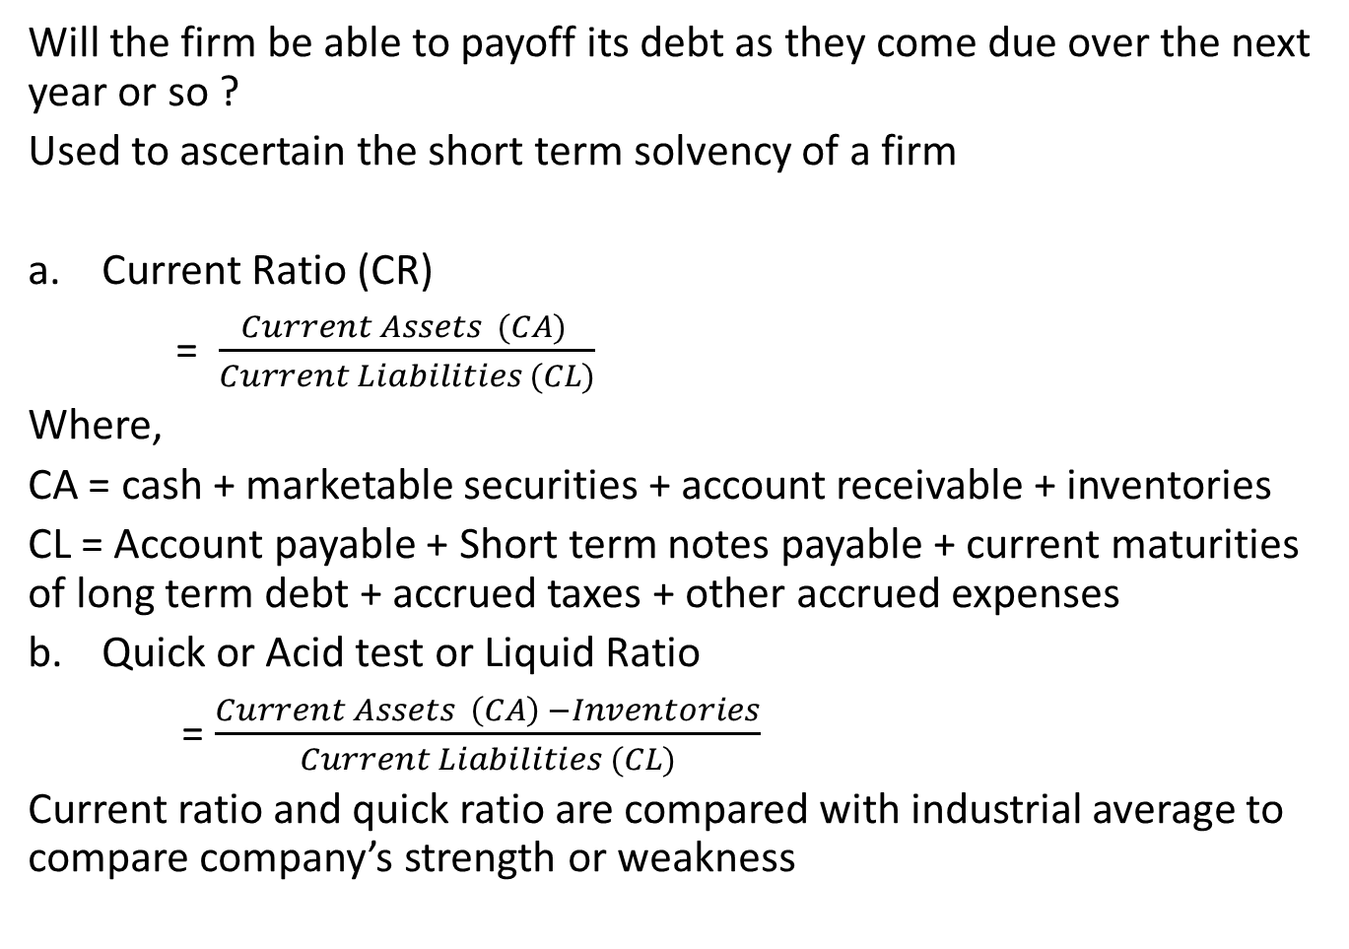
Liquidity Ratio
Will the firm be able to payoff its debt as they come due over the next year or so ?
Used to ascertain the short term solvency of a firm
Current Ratio (CR)
= $\frac{Current Assets (CA) }{Current Liabilities (CL)}$
Where,
CA = cash + marketable securities + account receivable + inventories
CL = Account payable + Short term notes payable + current maturities of long term debt + accrued taxes + other accrued expenses
Quick or Acid test or Liquid Ratio
= $\frac{Current Assets \left(CA\right) −Inventories}{Current Liabilities (CL)}$
Current ratio and quick ratio are compared with industrial average to compare company’s strength or weakness

Slide 15
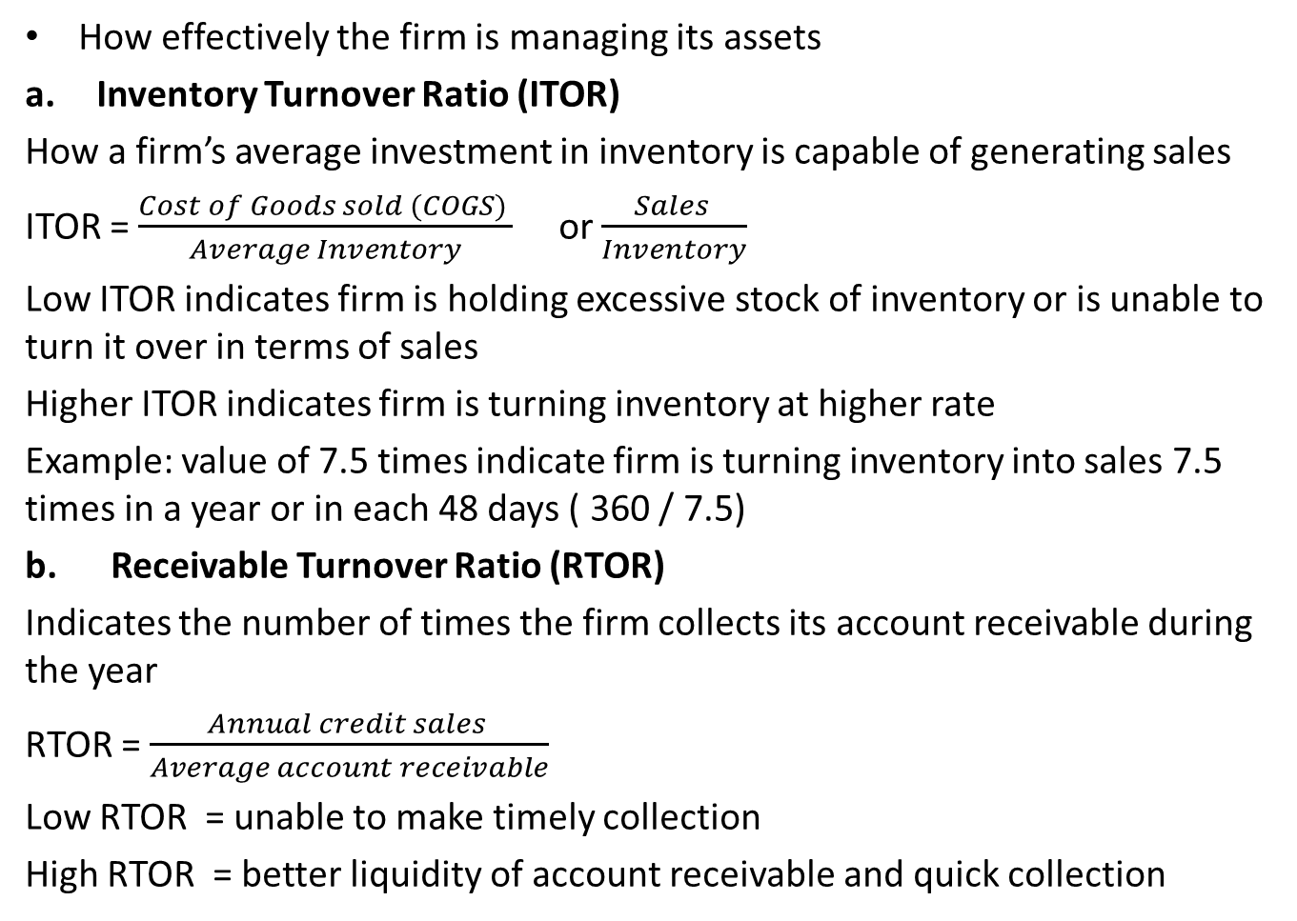
Asset Management Ratio
How effectively the firm is managing its assets
Inventory Turnover Ratio (ITOR)
How a firm’s average investment in inventory is capable of generating sales
ITOR = $\frac{Cost of Goods sold (COGS) }{Average Inventory}$ or $\frac{Sales }{Inventory}$
Low ITOR indicates firm is holding excessive stock of inventory or is unable to turn it over in terms of sales
Higher ITOR indicates firm is turning inventory at higher rate
Example: value of 7.5 times indicate firm is turning inventory into sales 7.5 times in a year or in each 48 days ( 360 / 7.5)
b. Receivable Turnover Ratio (RTOR)
Indicates the number of times the firm collects its account receivable during the year
RTOR = $\frac{Annual credit sales }{Average account receivable}$
Low RTOR = unable to make timely collection
High RTOR = better liquidity of account receivable and quick collection

Slide 16
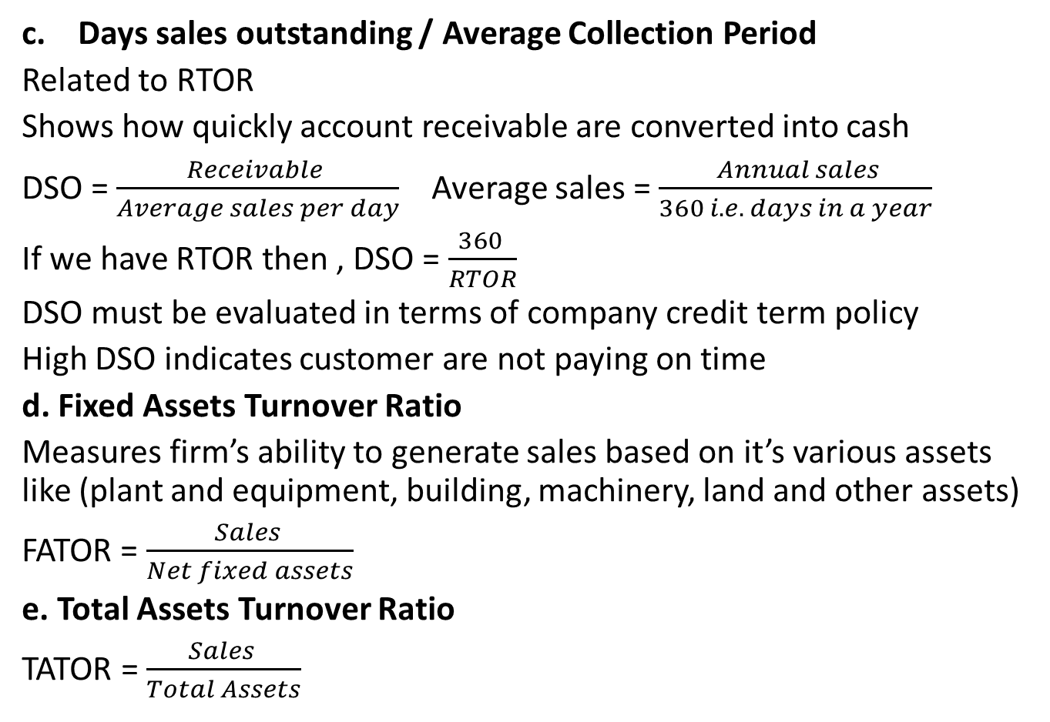
Asset Management Ratio
c. Days sales outstanding / Average Collection Period
Related to RTOR
Shows how quickly account receivable are converted into cash
DSO = $\frac{Receivable }{Average sales per day}$ Average sales = $\frac{ Annual sales}{360 i.e. days in a year}$
If we have RTOR then , DSO = $\frac{360 }{RTOR}$
DSO must be evaluated in terms of company credit term policy
High DSO indicates customer are not paying on time
d. Fixed Assets Turnover Ratio
Measures firm’s ability to generate sales based on it’s various assets like (plant and equipment, building, machinery, land and other assets)
FATOR = $\frac{Sales }{Net fixed assets}$
e. Total Assets Turnover Ratio
TATOR = $\frac{Sales }{Total Assets}$

Slide 17
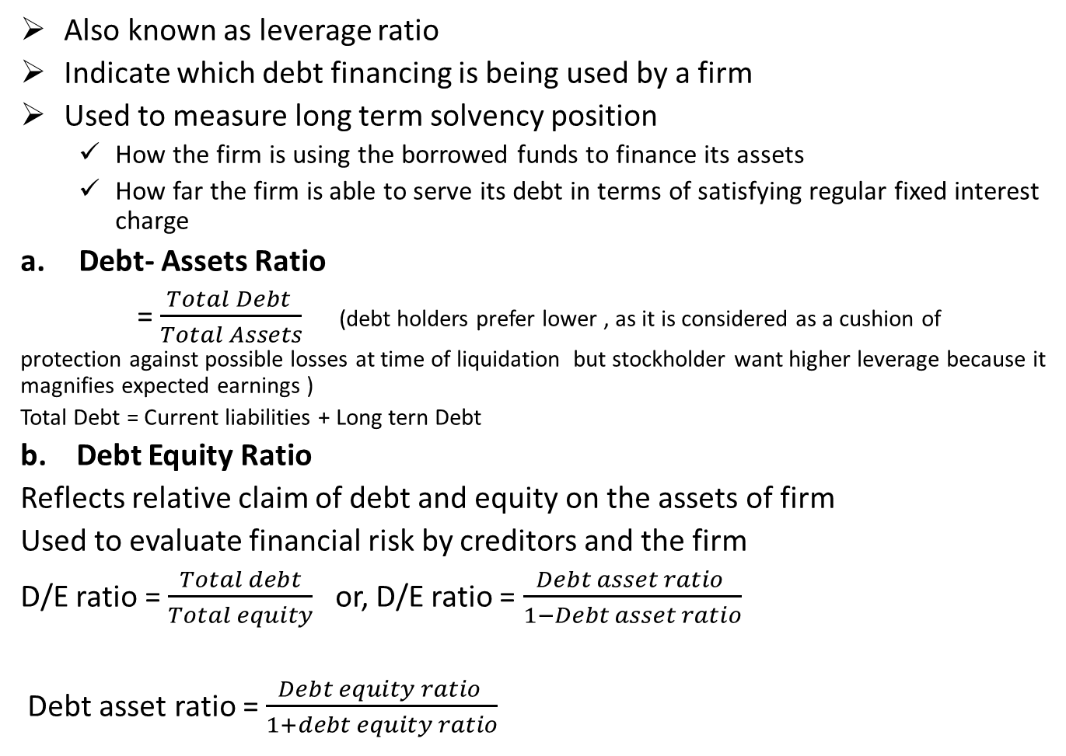
Debt Management Ratio
Also known as leverage ratio
Indicate which debt financing is being used by a firm
Used to measure long term solvency position
How the firm is using the borrowed funds to finance its assets
How far the firm is able to serve its debt in terms of satisfying regular fixed interest charge
Debt- Assets Ratio
= $\frac{Total Debt }{Total Assets}$ (debt holders prefer lower , as it is considered as a cushion of
protection against possible losses at time of liquidation but stockholder want higher leverage because it magnifies expected earnings )
Total Debt = Current liabilities + Long tern Debt
b. Debt Equity Ratio
Reflects relative claim of debt and equity on the assets of firm
Used to evaluate financial risk by creditors and the firm
D/E ratio = $\frac{Total debt}{Total equity}$ or, D/E ratio = $\frac{Debt asset ratio }{1−Debt asset ratio}$
Debt asset ratio = $\frac{Debt equity ratio }{1+debt equity ratio}$

Slide 18
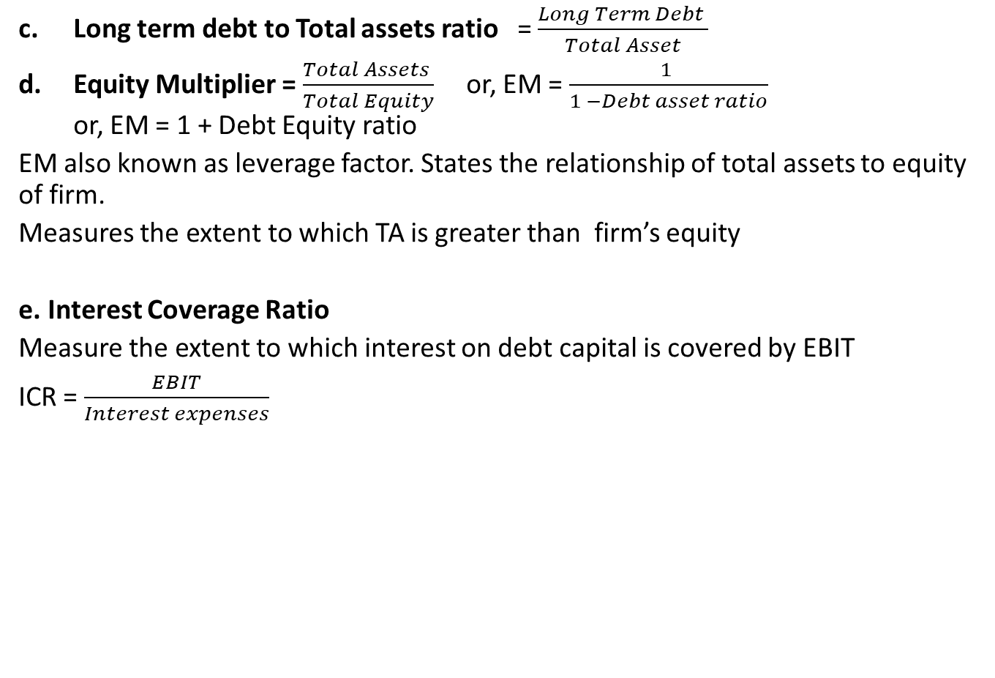
Debt Management Ratio
Long term debt to Total assets ratio = $\frac{Long Term Debt }{Total Asset}$
Equity Multiplier = $\frac{Total Assets }{Total Equity}$ or, EM = $\frac{1 }{1 −Debt asset ratio}$ or, EM = 1 + Debt Equity ratio
EM also known as leverage factor. States the relationship of total assets to equity of firm.
Measures the extent to which TA is greater than firm’s equity
e. Interest Coverage Ratio
Measure the extent to which interest on debt capital is covered by EBIT
ICR = $\frac{EBIT}{Interest expenses}$

Slide 19
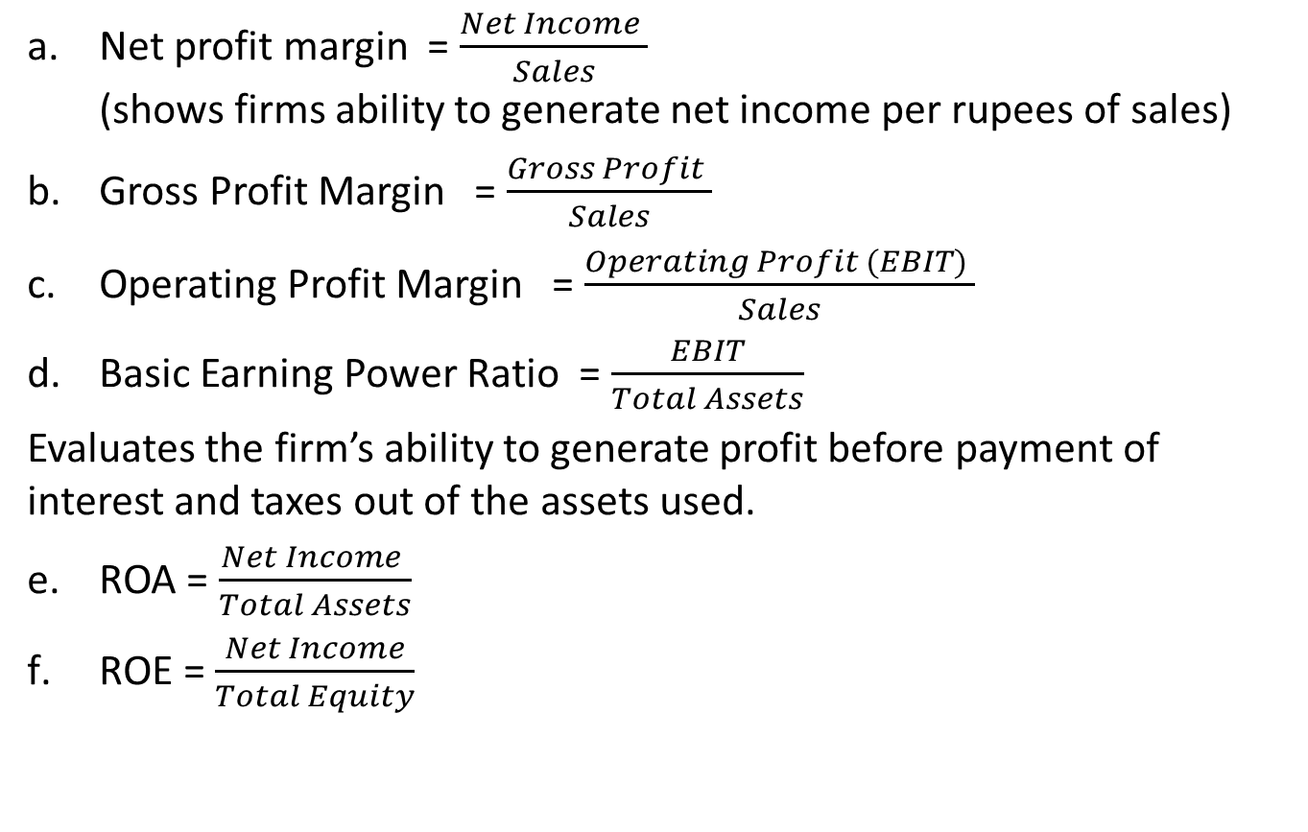
Profitability Ratio
Net profit margin = $\frac{Net Income }{Sales}$ (shows firms ability to generate net income per rupees of sales)
Gross Profit Margin = $\frac{Gross Profit }{Sales}$
Operating Profit Margin = $\frac{Operating Profit (EBIT) }{Sales}$
Basic Earning Power Ratio = $\frac{EBIT}{Total Assets}$
Evaluates the firm’s ability to generate profit before payment of interest and taxes out of the assets used.
ROA = $\frac{Net Income }{Total Assets}$
ROE = $\frac{Net Income}{Total Equity}$

Slide 20
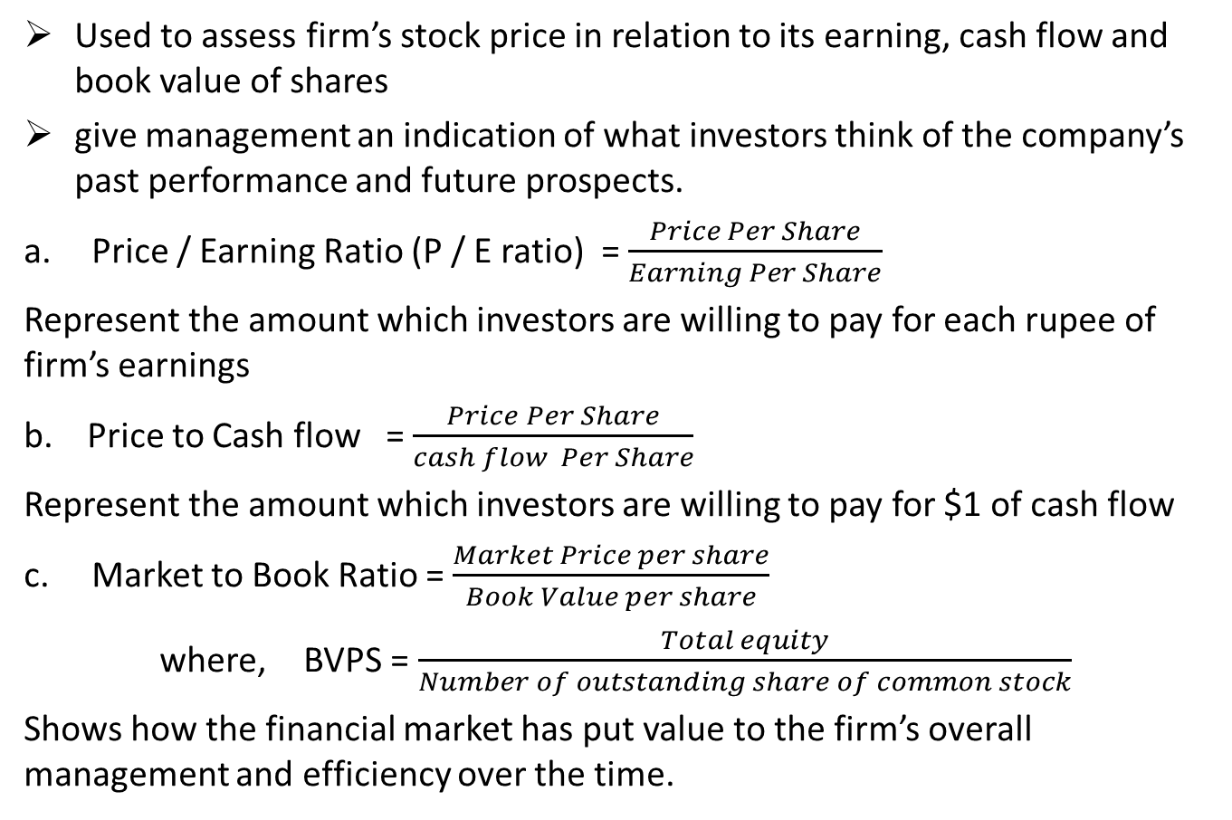
Market Value Ratio
Used to assess firm’s stock price in relation to its earning, cash flow and book value of shares
give management an indication of what investors think of the company’s past performance and future prospects.
Price / Earning Ratio (P / E ratio) = $\frac{Price Per Share}{Earning Per Share}$
Represent the amount which investors are willing to pay for each rupee of firm’s earnings
b. Price to Cash flow = $\frac{Price Per Share}{cash flow Per Share}$
Represent the amount which investors are willing to pay for $1 of cash flow
Market to Book Ratio = $\frac{Market Price per share}{Book Value per share}$
where, BVPS = $\frac{Total equity}{Number of outstanding share of common stock}$
Shows how the financial market has put value to the firm’s overall management and efficiency over the time.

Slide 21
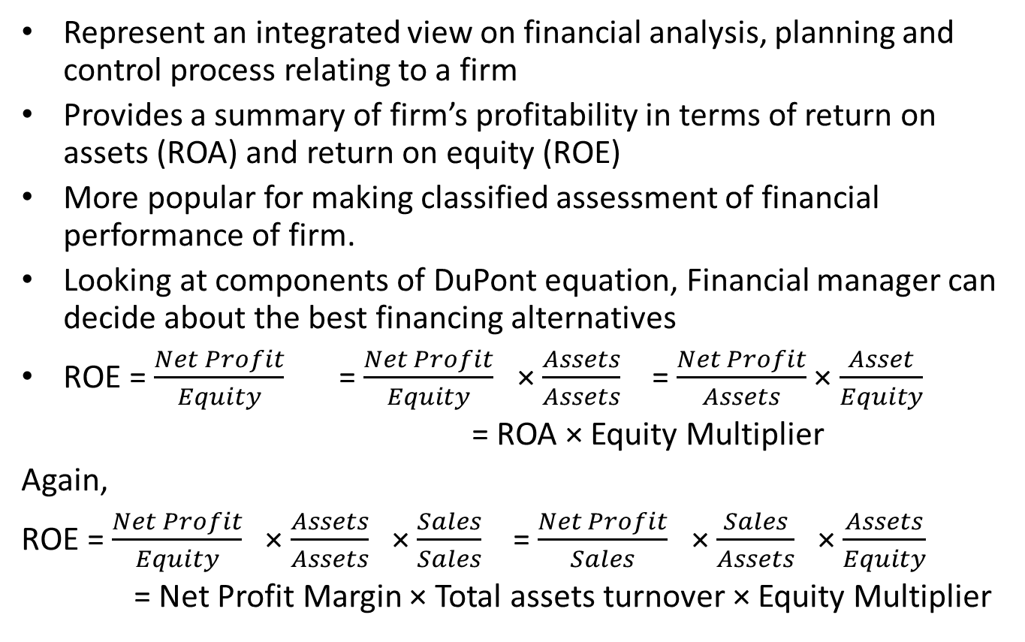
DuPont system of financial ratio analysis
Represent an integrated view on financial analysis, planning and control process relating to a firm
Provides a summary of firm’s profitability in terms of return on assets (ROA) and return on equity (ROE)
More popular for making classified assessment of financial performance of firm.
Looking at components of DuPont equation, Financial manager can decide about the best financing alternatives
ROE = $\frac{Net Profit}{Equity}$ = $\frac{Net Profit}{Equity}$ × $\frac{Assets}{Assets}$ = $\frac{Net Profit}{Assets}$ × $\frac{Asset}{Equity}$
= ROA × Equity Multiplier
Again,
ROE = $\frac{Net Profit}{Equity}$ × $\frac{Assets}{Assets}$ × $\frac{Sales}{Sales}$ = $\frac{Net Profit}{Sales}$ × $\frac{Sales}{Assets}$ × $\frac{Assets}{Equity}$
= Net Profit Margin × Total assets turnover × Equity Multiplier

Slide 22
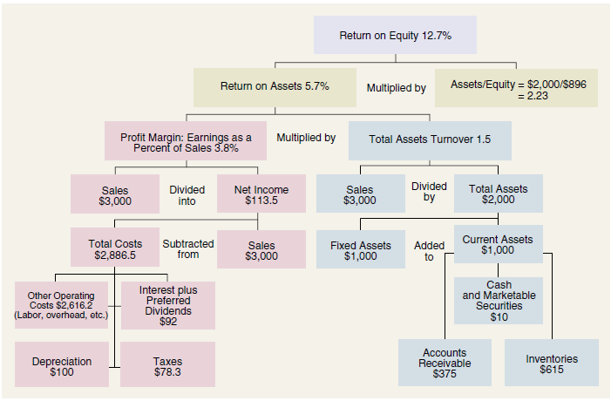

Slide 23
Comparative Ratios and Benchmarking

Slide 24
Users and usefulness of financial ratios
Management, owners, employees are the internal users and the creditors, credit rating agencies, government, customers, researchers and scholars are the external users.
Financial ratios are used by different users for various purposes as:
Useful in managerial performance evaluation
Useful in credit analysis
Useful in stock analysis
Useful in vertical and horizontal analysis
Useful in internal and external comparison

Slide 25
Potential Problems and Limitations of Ratio Analysis
Based on accounting information
Lack of standard for comparison
Price level changes
Seasonal and cyclic effect in Business
Chances of manipulation and window dressing
Changes in accounting policy and standards
Chances of subjective interpretation and judgements

Slide 26
Qualitative factors analyst should consider when evaluating a company's future financial performance
Business goals and objectives
Performance of management team
Product quality
Customer loyalty and power of brand
Role value net and coopetition in the business
The state of economy
Other external factors

Slide 27
Assignment Case:
In word file

